Slide 1
Artificial Brain
Addi Rowe

Slide 2
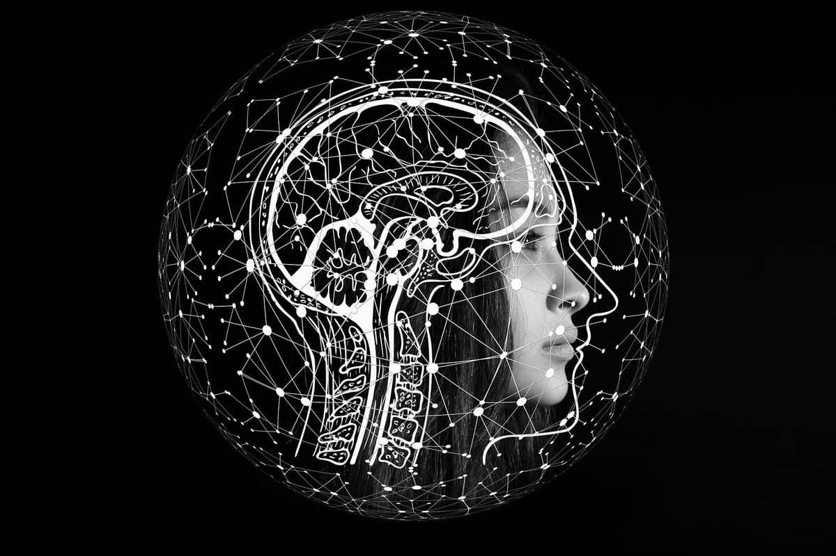
Overview
History 1&2 -
Plans and implementations-
Pros 6&7-
Cons 8&9-
Summary
References

Slide 3
History
In addition to creating the first neural network and graphical headgear, MIT professor Marvin Minsky also created one of the earliest programmable robots. AI shares several properties with human brains, specifically with neurons. He came up with this idea in August 9, 1927. AI shares several properties with human brains, specifically with neurons. In deep neural networks, 'units' refer to the equivalent components. These modules are interconnected like neurons, transferring data across different levels.
Notes:
In addition to creating the first neural network and graphical headgear, MIT professor Marvin Minsky also created one of the earliest programmable robots. AI shares several properties with human brains, specifically with neurons. He came up with this idea in August 9, 1927.

Slide 4
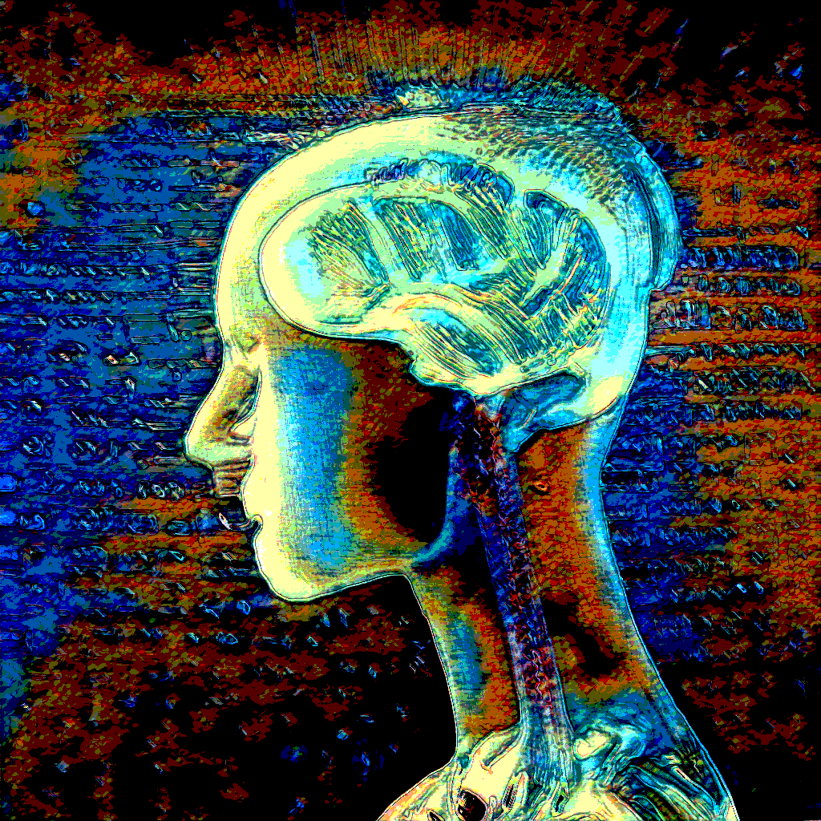
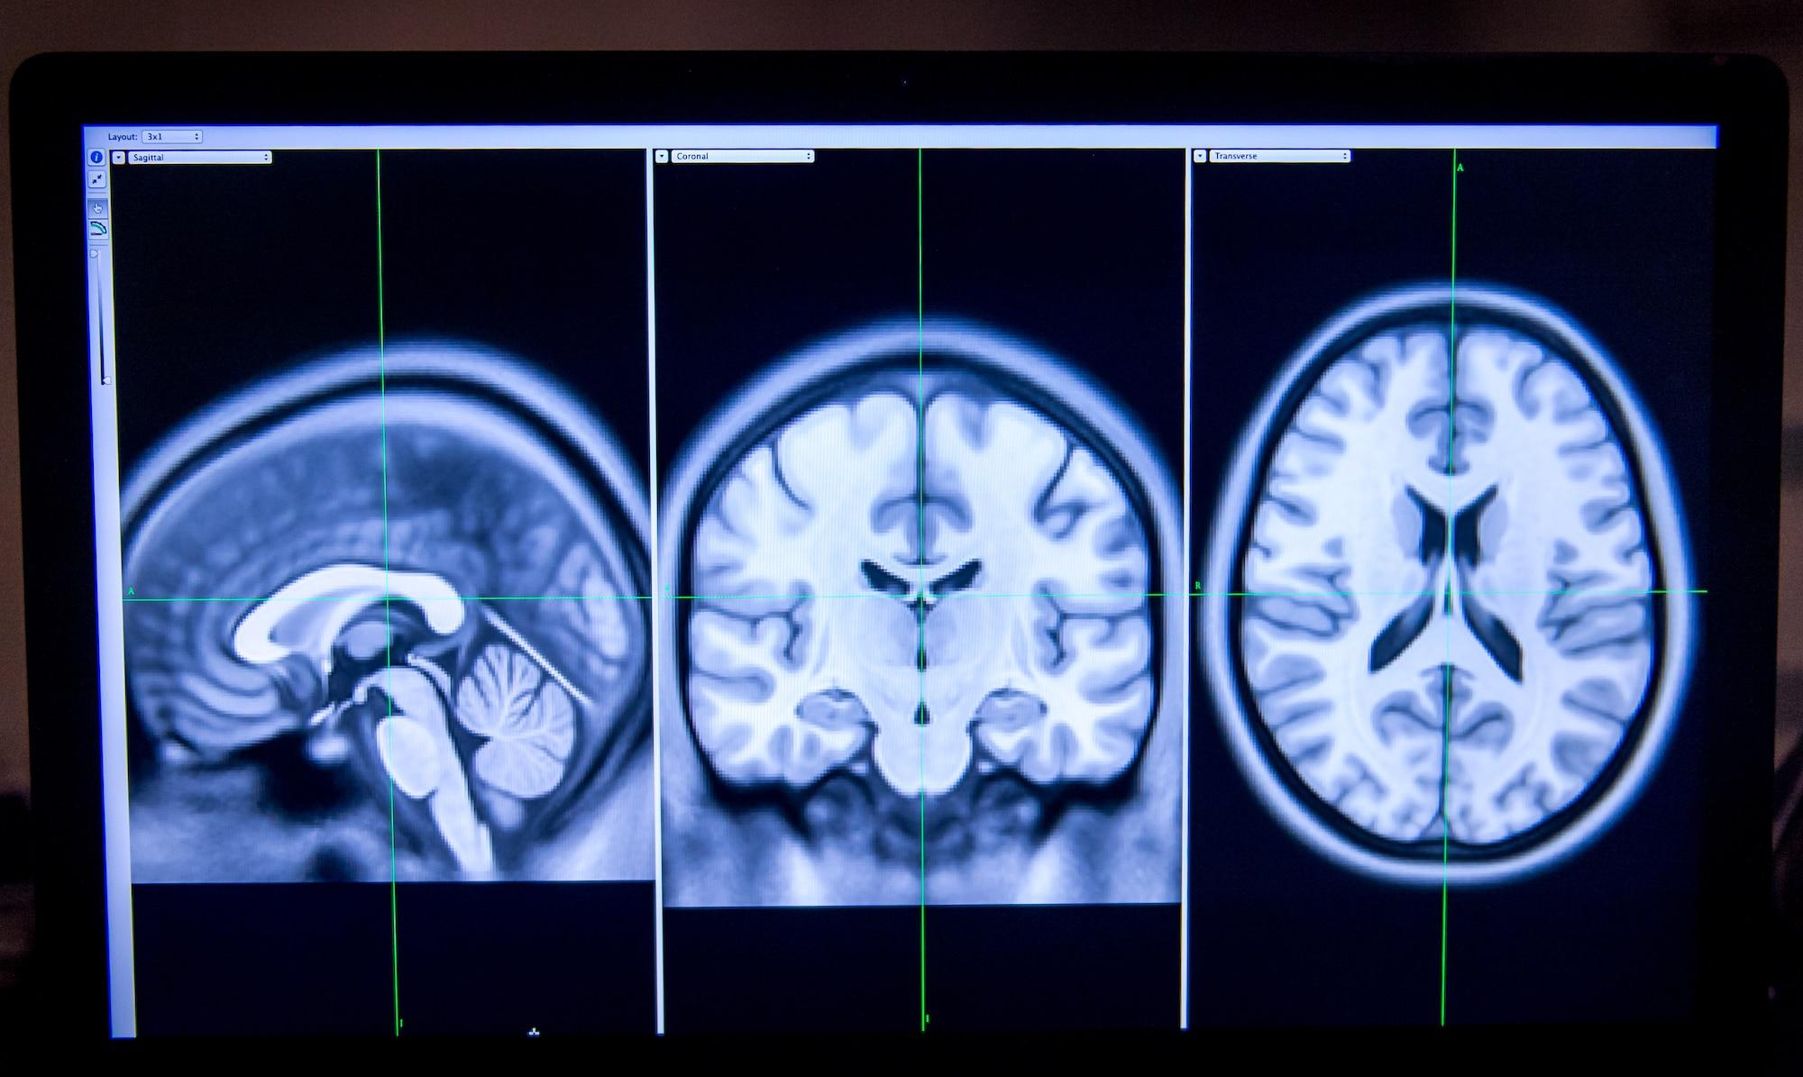
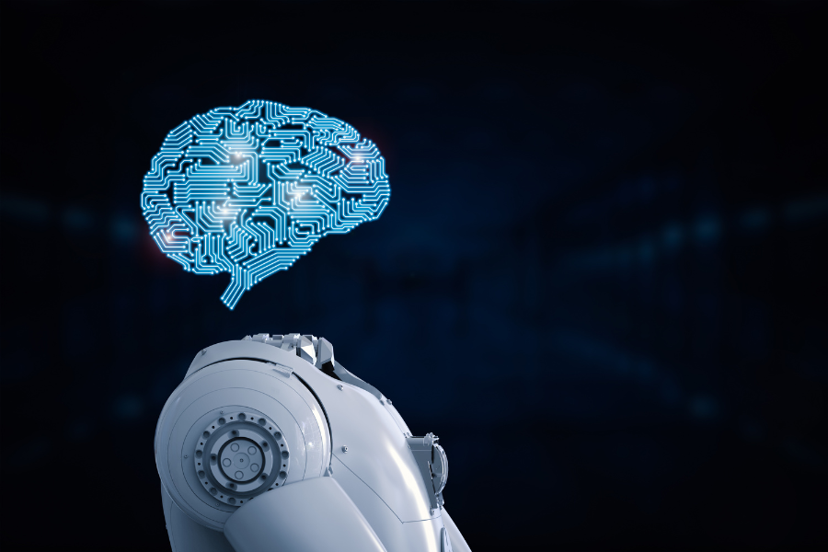
History

Slide 5
Plan and Implementation
If we could make artificial brains and actually use them they could save so many lives. They could be used for people with brain tumors that aren't resectable. They could be used for people that get in bad accidents or go brain dead so then they can have another chance at life. These could be used for so many good things and one day if they become a real thing it will change medical history.
Notes:
If we could make artificial brains and actually use them they could save so many lives. They could be used for people with brain tumors that aren't resectable. They could be used for people that get in bad accidents or go brain dead so then they can have another chance at life. These could be used for so many good things and one day if they become a real thing it will change medical history.

Slide 6

Pros
Diminishes Human Error
Facilitates Faster Decision Making
Offers Continual 24/7 Availability
Lessens Risk
Notes:
Some of the pros of an artificial brain could be that is diminishes the risk of human error, it Facilitates Faster Decision Making, it also Offers Continual 24/7 Availability and lastly it lessened risk of a lot of things.

Slide 7
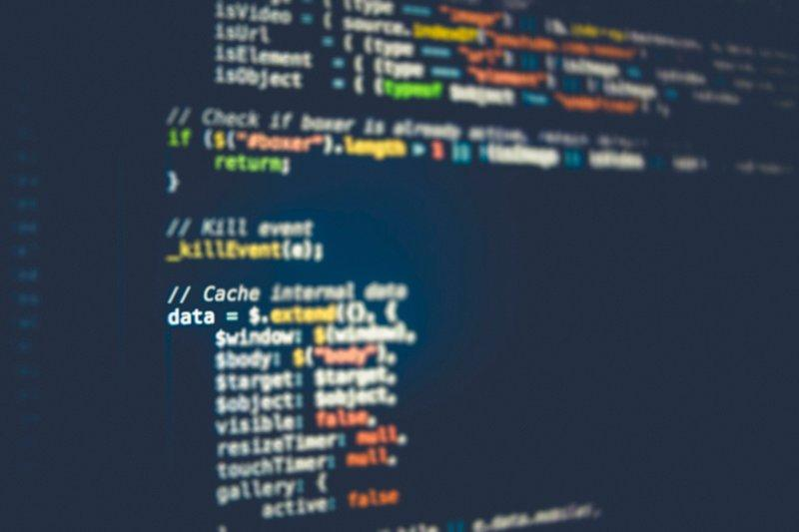
Pros
Automates Repetition
Provides Digital Assistants
Identifies Patterns
Identifies Better Human Workflows
Notes:
Some more pros include Automates Repetition, Provides Digital Assistants, Identifies Patterns and it Identifies Better Human Workflows.

Slide 8
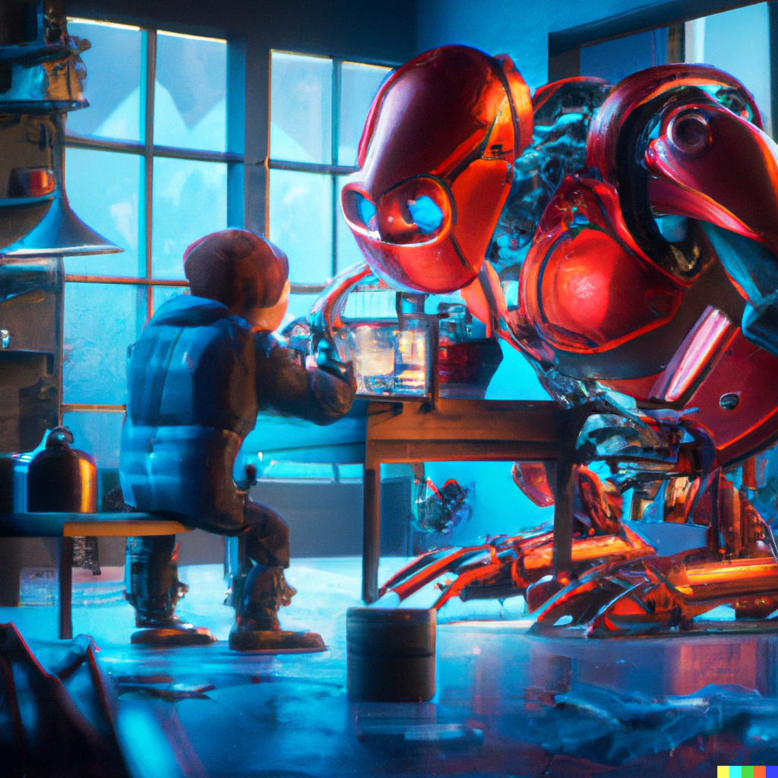
Cons
costly implementation
potential human job loss
Notes:
Some of the cons are costly implementation and potential human job loss.

Slide 9
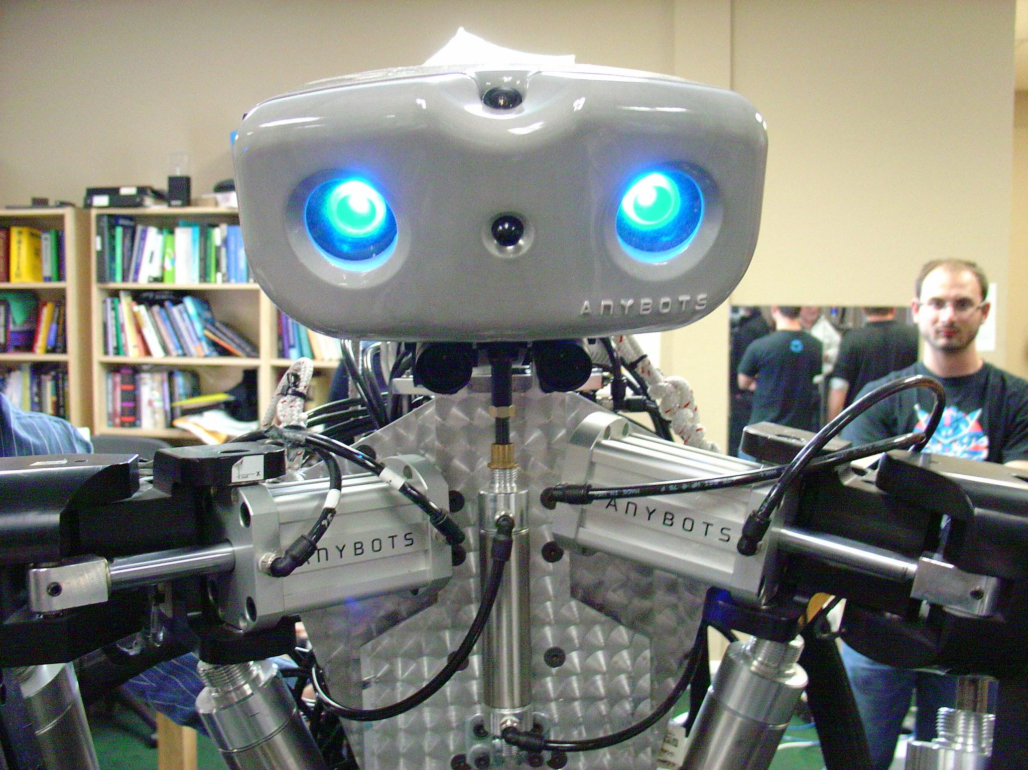
Cons
Another big con is lack of emotion and creativity.
Notes:
The last big con is that by doing this it may cause a lack of creativity and human emotion.

Slide 10
Summary
I am for the change in technology it is going to help us grow as a society and also has a lot more benefits. It is going to help save lives and help us grow smarter and advance more in the future. It does have some flaws right now but i think as long and we keep our priorities straight and keep human vs technology separate it will better us in the future. As the world grows we need to grow with it and if we don't then there will be no “us” anymore. If we can find a way to make artificial brains it help eliminate eros and deaths that we cant afford in order to keep going as a society. Although it is far in the future i think that it is needed and going to be a good change.

Slide 11
Reference
https://indiaai.gov.in/article/who-invented-the-artificial-brain
https://rockcontent.com/blog/artificial-intelligence-pros-and-cons/
https://www.tableau.com/data-insights/ai/advantages-disadvantages#:~:text=The%20advantages%20range%20from%20streamlining,lack%20of%20emotion%20and%20creativity.

